Slide 1

Data Science Challenge
- Airbnb Berlin -
Presentation
Stanislas Furrer
Lausanne, Switzerland
Email: stanislas.furrer@gmail.com
09.12.2021
Notes:
I am delighted to present you this Morning my Data Analysis on the Airbnb Listening of Berlin
In this presentation, I won’t enter to much into the detail but rather present the main decision and assumption that as lead me to the results.

Slide 2

Introduction The Story
It’s March 2017. Rob, a KPMG employee living in Berlin, lives moving in and out Airbnb’s and never shares his current address. He would like to invite a few D&A colleagues at his place for a dinner evening and decides to share the key features of his current rental.
The D&A team needs to figure out where Rob is most likely living. The task is therefore to create a model that, given a set of features, for a set of coordinates (latitude, longitude), calculates a score that quantifies how likely it is that Rob is living at the given latitude-longitude.
Task Classification/Recommendation Algorithm to predict the current locations of Rob
Constraint Not too intrusive, we need to predict in which of the 96 boroughs of Berlin Rob is likely to live
Score The likelihood of Rob living in each of the 96 borough is the confidence score of the model
Notes:
1. The project has been initiated by a Story and I will start by summarize it for you.
2. As a Data Scientist, our first task here is to understand the target, the constraint and set some assumptions in order to fit the task provided by the stakeholder or a company.
3. Our task is to create a classification / recommendation Alrogithm to predict the current location of ROB
4. Here we need to define what current location mean by setting a first counstraint. Being not too intrusive
5. We will therefore limit our prediction to “In which of the 96 boroughs of Berlin Rob is likely to live”
6. Now the question is How can we quantify this likelihood ? We define a score which the confidence score of our predictive models. Specifically, when our model will make is prediction about where is the most likely place where Rob might live, he will output probability. These probability will be our likelihood score.
We know have set our target, constraint and a solution for quantifying the likelihood of Rob living in each of the 96 Borough of Berlin

Slide 3



Introduction The Plan
Descriptive Analytics
Predictive Analytics
Prescriptive Analytics
Notes:
Our plan for solving the Task is divided into three equally important part :
A descriptive task where we will understand every aspect of the data; the relation between each features there distribution and joint distribution. Handling the missing element through imputation and making a lot of statistical tests.
A predictive Part, where we will select our final features, models and framework for solving our tasks
Finally we will conduct a prescriptive analysis in order to interpret the output and leverage the synergies between the descriptive analytics and the predictive analytic in order to fit as well as possible our task. Broadly speaking, it is the human in the loop. We try to make the most from our pipeline.
That’s being said, in this presentation I will mostly focus on the predictive and prescriptive part and afterward I will respond to any of you questions regarding the descriptive part

Slide 4
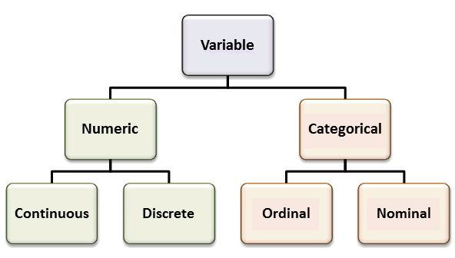
Predictive Analytics The Features, Metrics and Models
The Features
Target Categorical : 96 Boroughs of Berlin
Numeric /Quantitative
Overall satisfaction (int) [0-5]
Accomodates (int) [0-16]
Bedrooms (int) [0-16]
Price (int) [0-12’600$]
Reviews (int) [0-400]
Distance to KPMG (float) [0-30km]
Categorical / Qualitative
Year [2015-2017]
Month [Jan-December]
Room type {Entire home/apt, Private room, Shared room}
Notes:
The features, the metric and the model
Starting with the features. We have several type of features. We select 9 features for our predictive part
6 of them are numeric with discret and continuous values
3 of them are categorical.
We need to predict the Score for the month of march 2017. We will use therefore the test set on march 2017 and the training set as all the data before this month
Our target is the 96 borough of berlin
Now I highlighted in green the two features that as been engineered.

Slide 5
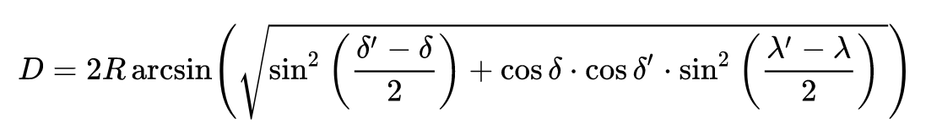
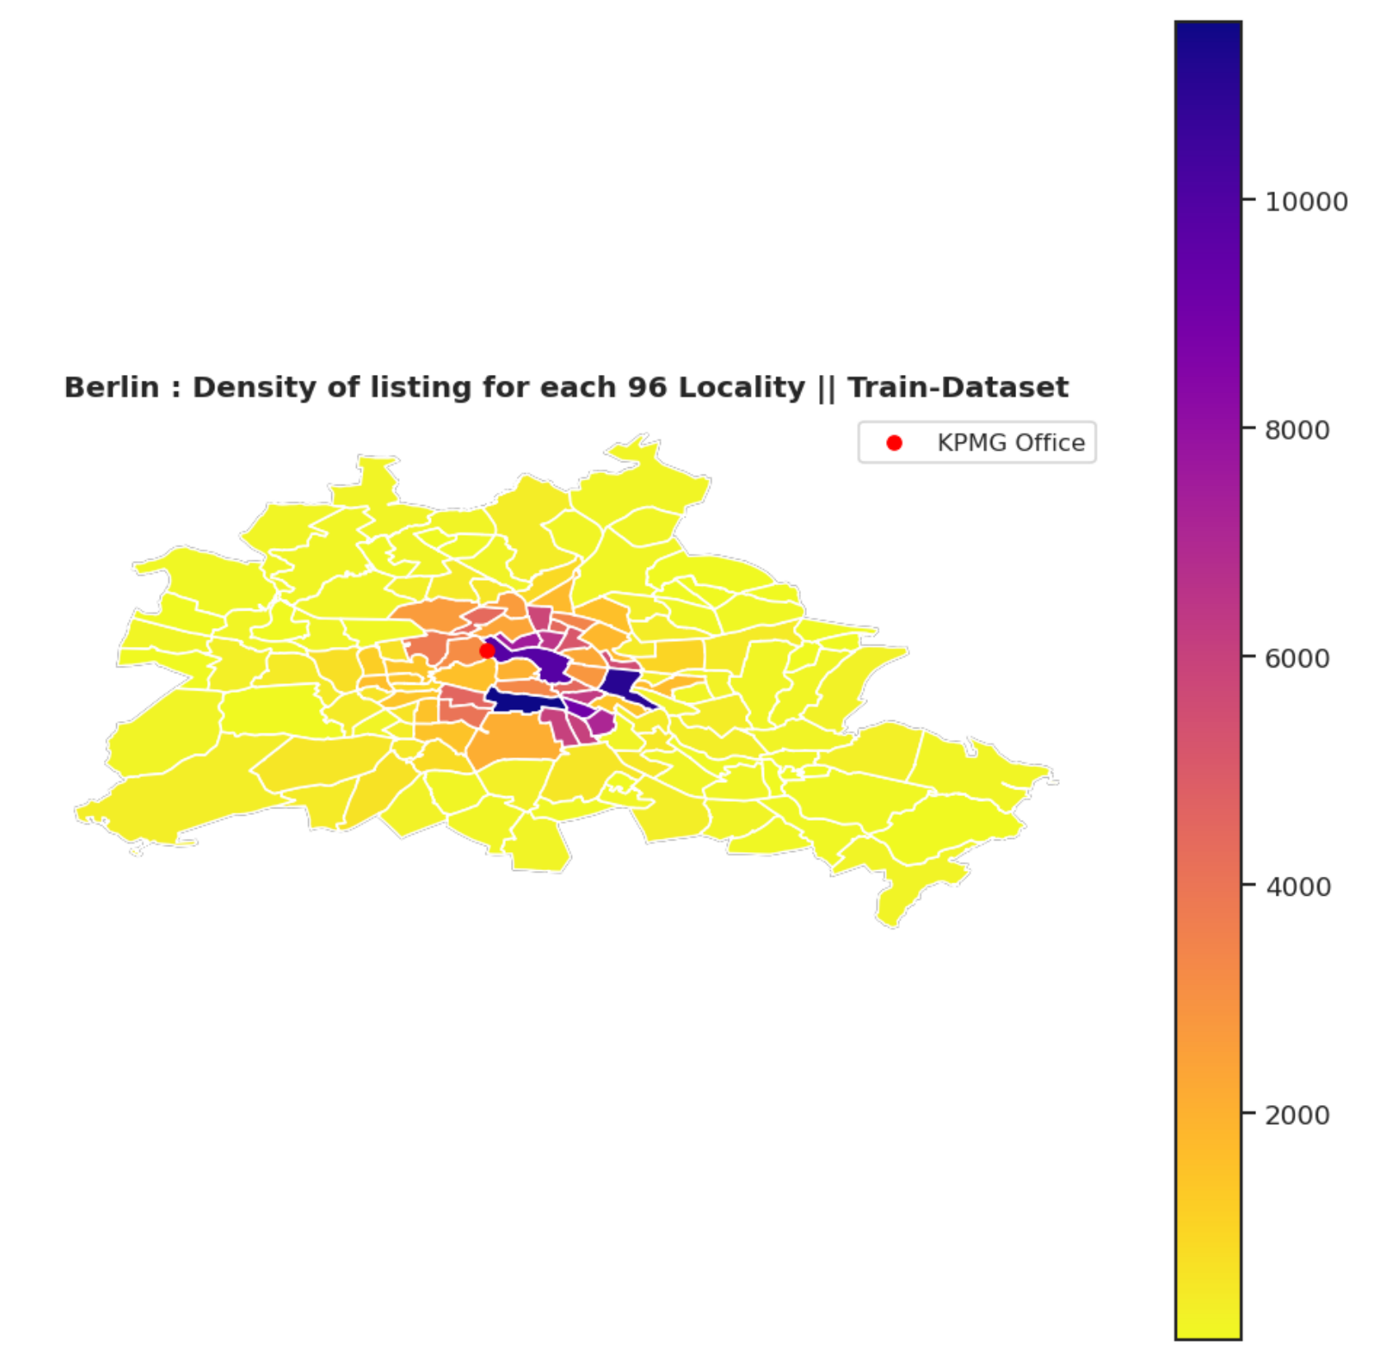
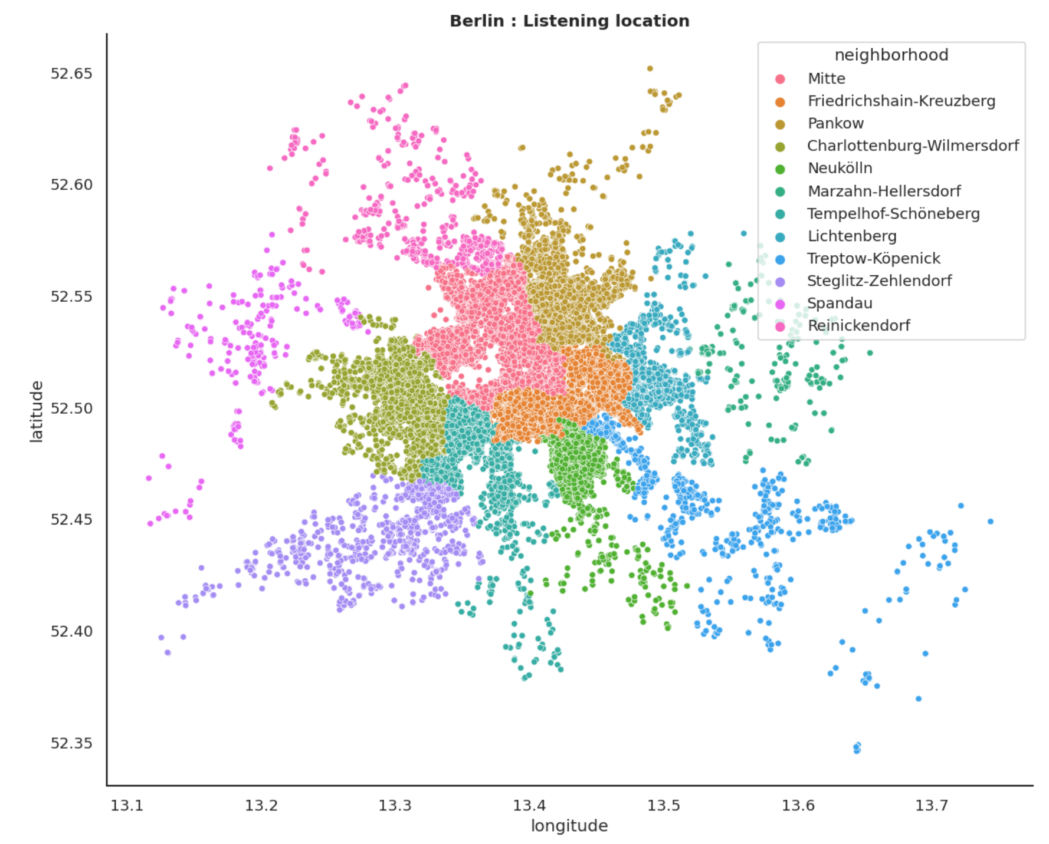
Predictive Analytics The Features, Metrics and Models
The Features Engineering
Target Categorical : 96 Boroughs of Berlin Long-Lat -> Borough
Features Numeric : Distance to KPMG Geodesic Distance
D
Notes:
Indeed, initially we have the information about the latitude and longitude of the Airbnb accommodation.
As mention, we constrain our prediction to the 96 borough of berlin. Therefore, I will assign for a given latitude and longitude a borough As we can see on this graph
I decide to add as features the distance to KPMG. Obviously when choosing a Airbnb we wish to be as close as possible to the most important places of the city. At least this is true for big cities. The natural choice would be to be close to the center or center of interest. For berlin it is particular since it doesn’t have real center. As a toy exemple I decide to assume that KPMG is the center of interest. It is a toy exemple, but it fits our task and it is not far from many famous places of berlin
I compute the distance to KPMG using the geodesic distance.

Slide 6
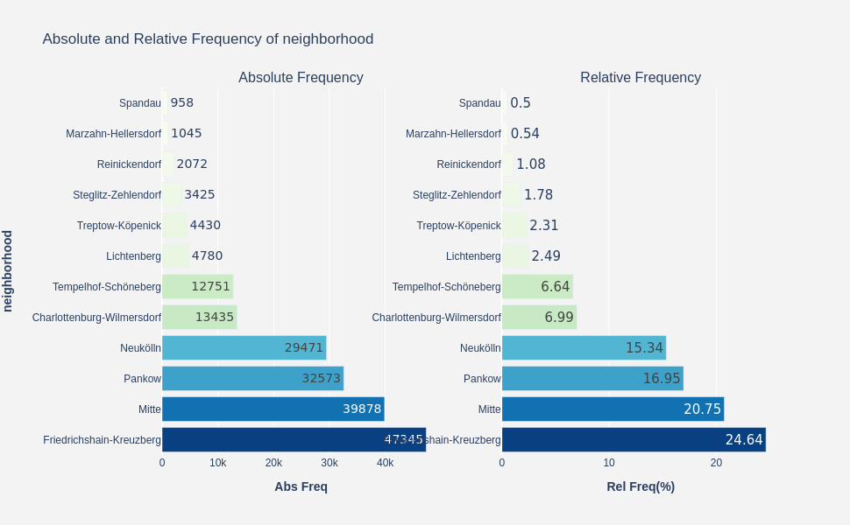
Predictive Analytics The Features, Metrics and Models
Observation1. Highly Unbalanced Dataset
Observation2. Recommender System
The Metrics
Notes:
We select our metric based on some observation :
Our dataset is highly unbalanced
Our task looks like a recommender system. Indeed we would like not only to have the most probable area of berlin but be at least confident that Rob is living in one of the 5 most probable area.
As we can see on these graph the dataset is unbalanced. On the left we have the density of listening per Locality and on the right the relative and absolute frequency.
The first four neighbood count as 77.68 % of the listening. Please note that there is 12 neighborhood in Berlin and 96 locality.

Slide 7
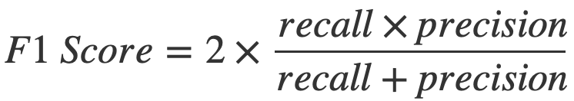
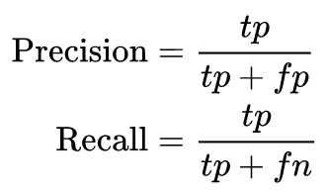
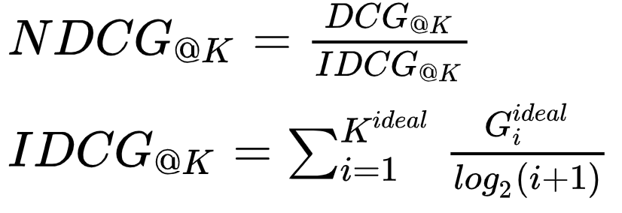
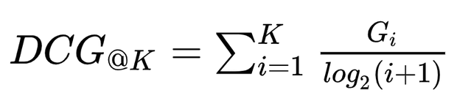
Predictive Analytics The Features, Metrics and Models
Observation1. Highly unbalanced Dataset
Observation2. Recommender System
The Metrics
F1 Score. Excellent metric for un-balanced classes
Penalize the False Negative
Penalize the False Positive
Normalized Discount Cumulative Gain (NDCG) Score. Excellent metric for Recommender Systems
DCG_K : Considering the top k prediction does the ground truth is in the list and in which positions?
NDCG : Normalization (Always divided by 1)
Notes:
* We will choose the f1 score as it is a really well suited metrc for un balanced classes. I won’t enter to much into the details
The second metric we choose is a standard metric for recommender system the normalized discount cumulative Gain.
Briefly, we would like the real answer to be included in the top 5 predictions. Additionally, we want the answer to be in the top 1 position rather than in the top 4. Therefore the ordering of the most probable location count. This is what does this metric. The Discount cumulative Gain. The normalization part might be ignore in our context. Shortly, we are devided our score by the idea score. In our context it is always 1.

Slide 8
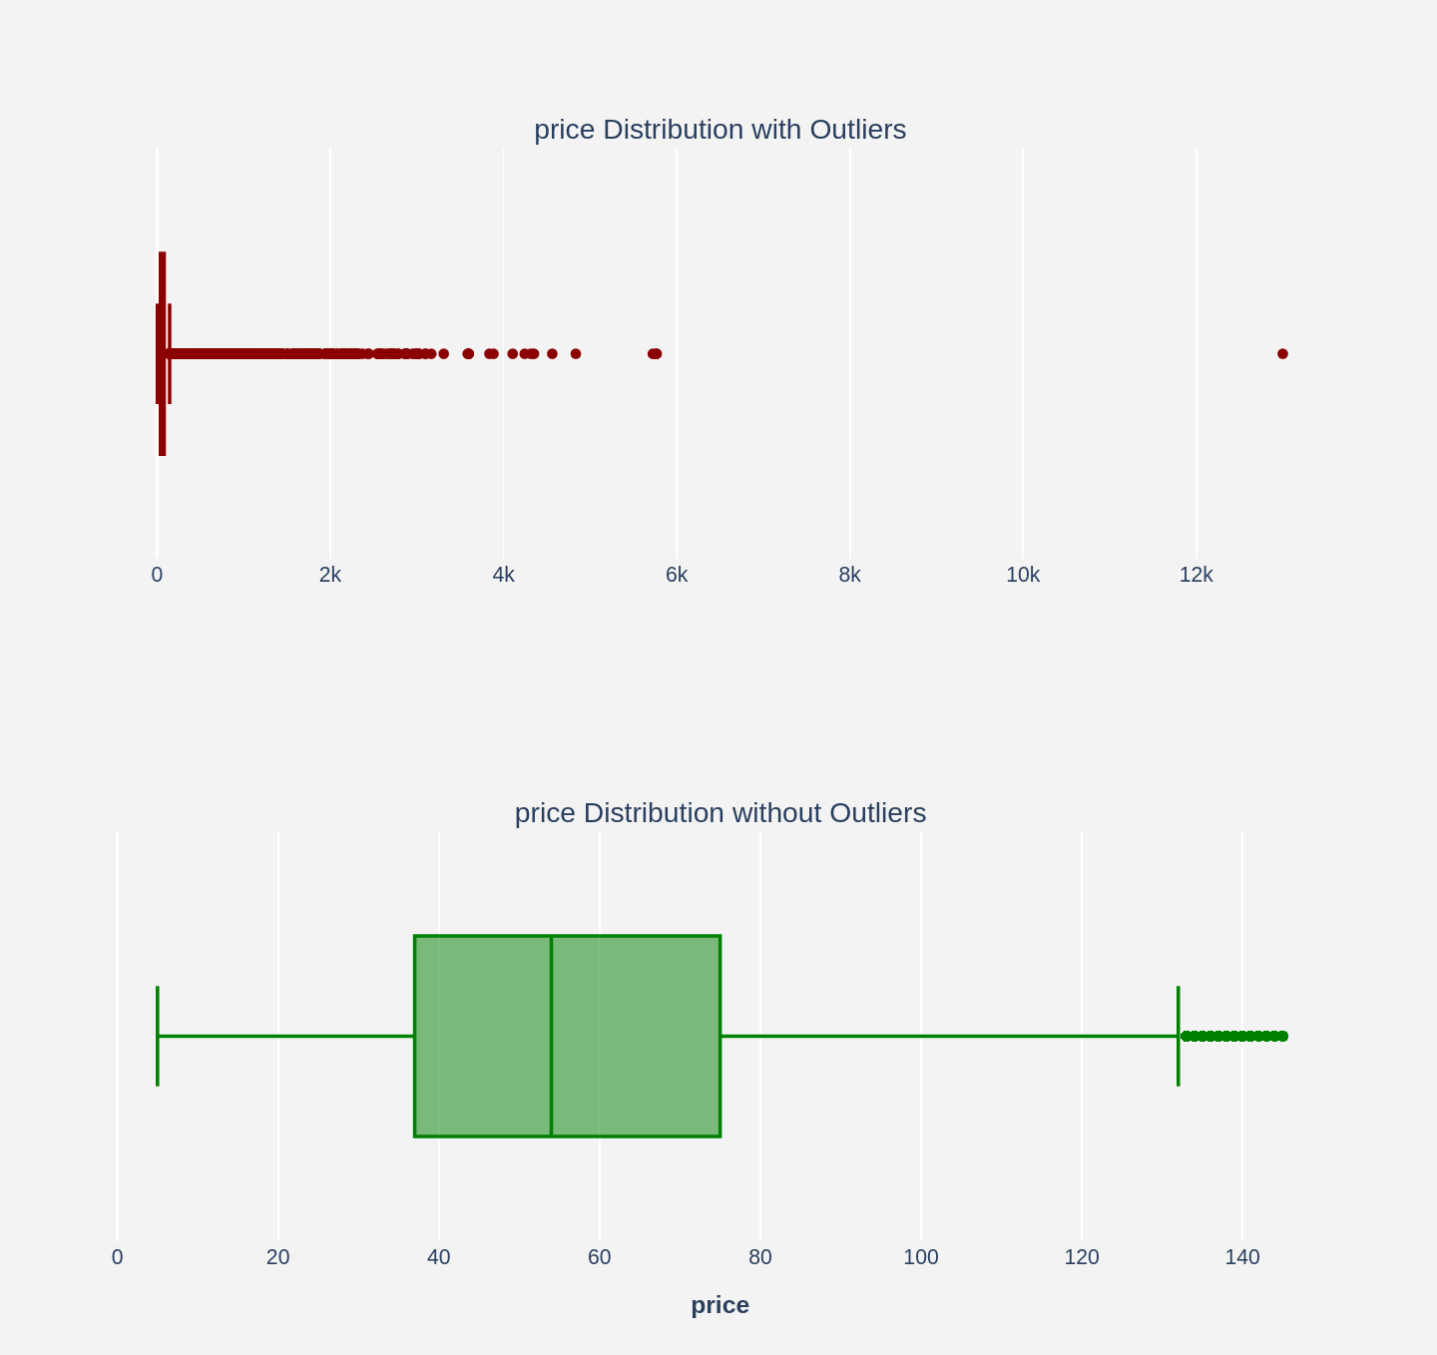
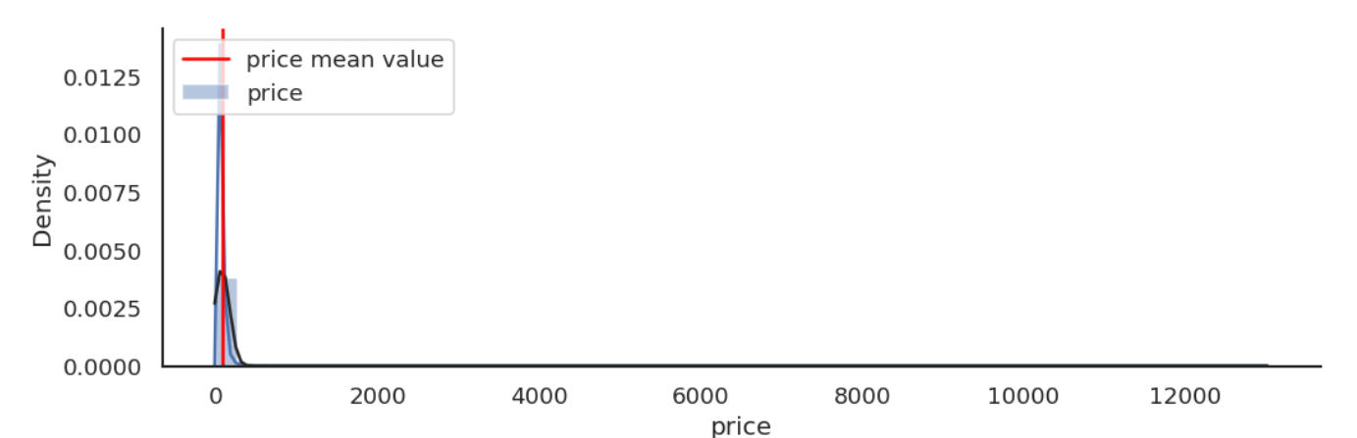
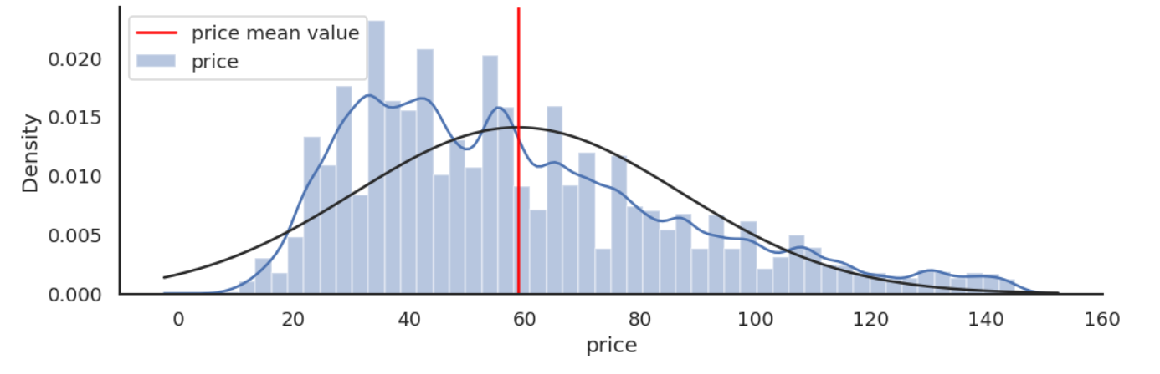
Predictive Analytics The Features, Metrics and Models
Observation1. Highly unbalanced Dataset
Observation2. Recommender System
Observation3. Outliers and features with different type
The Models
Price With Outlier
Price Without Outlier
Notes:
1.Our third observation is that our dataset contain many outliers and different type of data. This is the price per night for the different Airbnb with the outliers and this is when we remove the outliers. Removing the outlier reduce the dataset of only 2 %.
2. We won’t remove the outliers because we will use models that handle such cases

Slide 9
Predictive Analytics The Features, Metrics and Models
Observation1. Highly unbalanced Dataset
Observation2. Recommender System
Observation3. Outliers and features with different type
The Models
Baseline Models.
- A lot of Assumptions to Handle
Logistic Regression
Naives Bayes
K-Nearest Neighbours
Tree Based Models.
+ Handle unbalanced Dataset
+ Handle Outlier and different type
+ Doesn’t required features normalization, binning etc…
Decision Tree
Random Forest (Ensembling)
XGBoosting (Ensembling)
Ensembling (Boosting And Bagging). Reduce de variance of the decision and well suited for unbalanced dataset
Notes:
* We select as baseline regular classification : Logistic regression, Naïve bayes and KNN. They require a lot of assumption about the data
We will favorize the tree based models as it handle
Decision tree, Random Forest and XGboosting

Slide 10
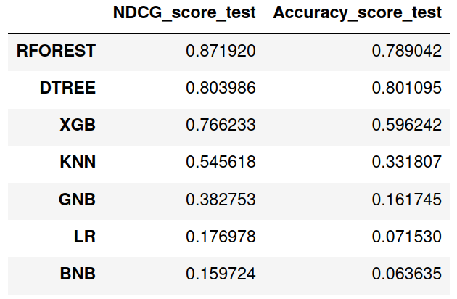
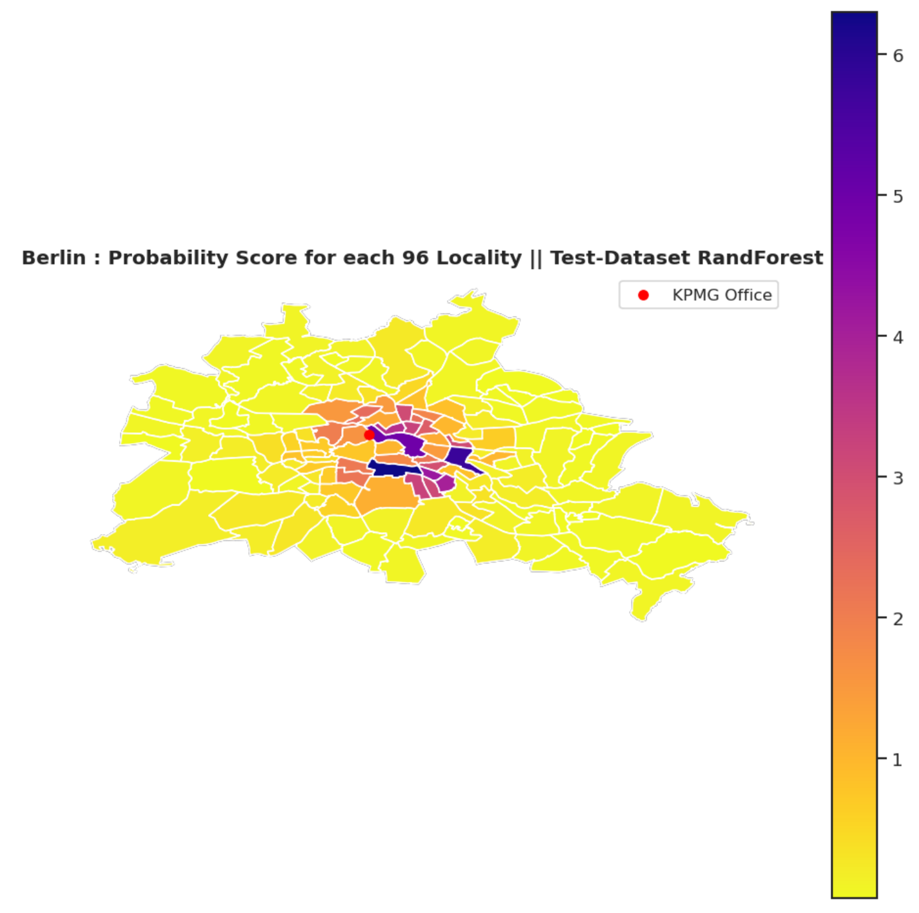
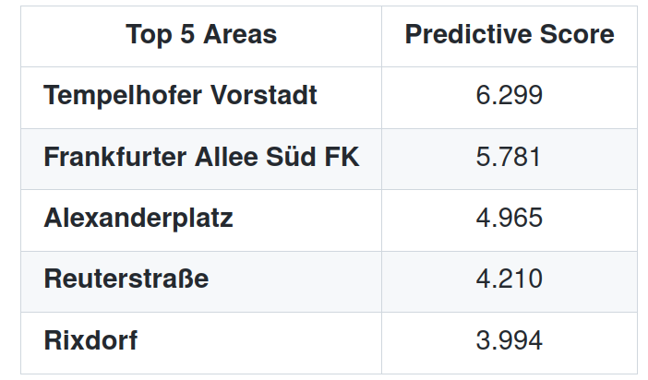
Predictive Analytics The Features, Metrics and Models
The Results
Notes:
Here are the result of our predictive model. As expected the tree based model make much better result and reliable than the baseline. The reliability is the NDCG score and the accuracy only tells us how accurate is our top1 prediction (we should have use the f1 score but I forgot to put it in the table)

Slide 11
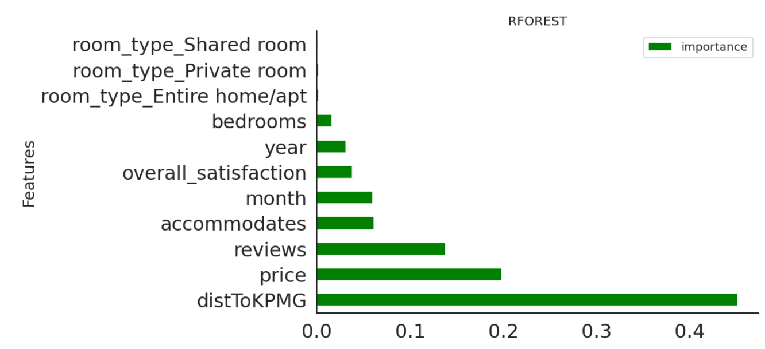
Predictive Analytics The Features, Metrics and Models
The Results
Notes:
We then want to understand what are the most important features in the prediction :
* Dist to KPMG price and review

Slide 12
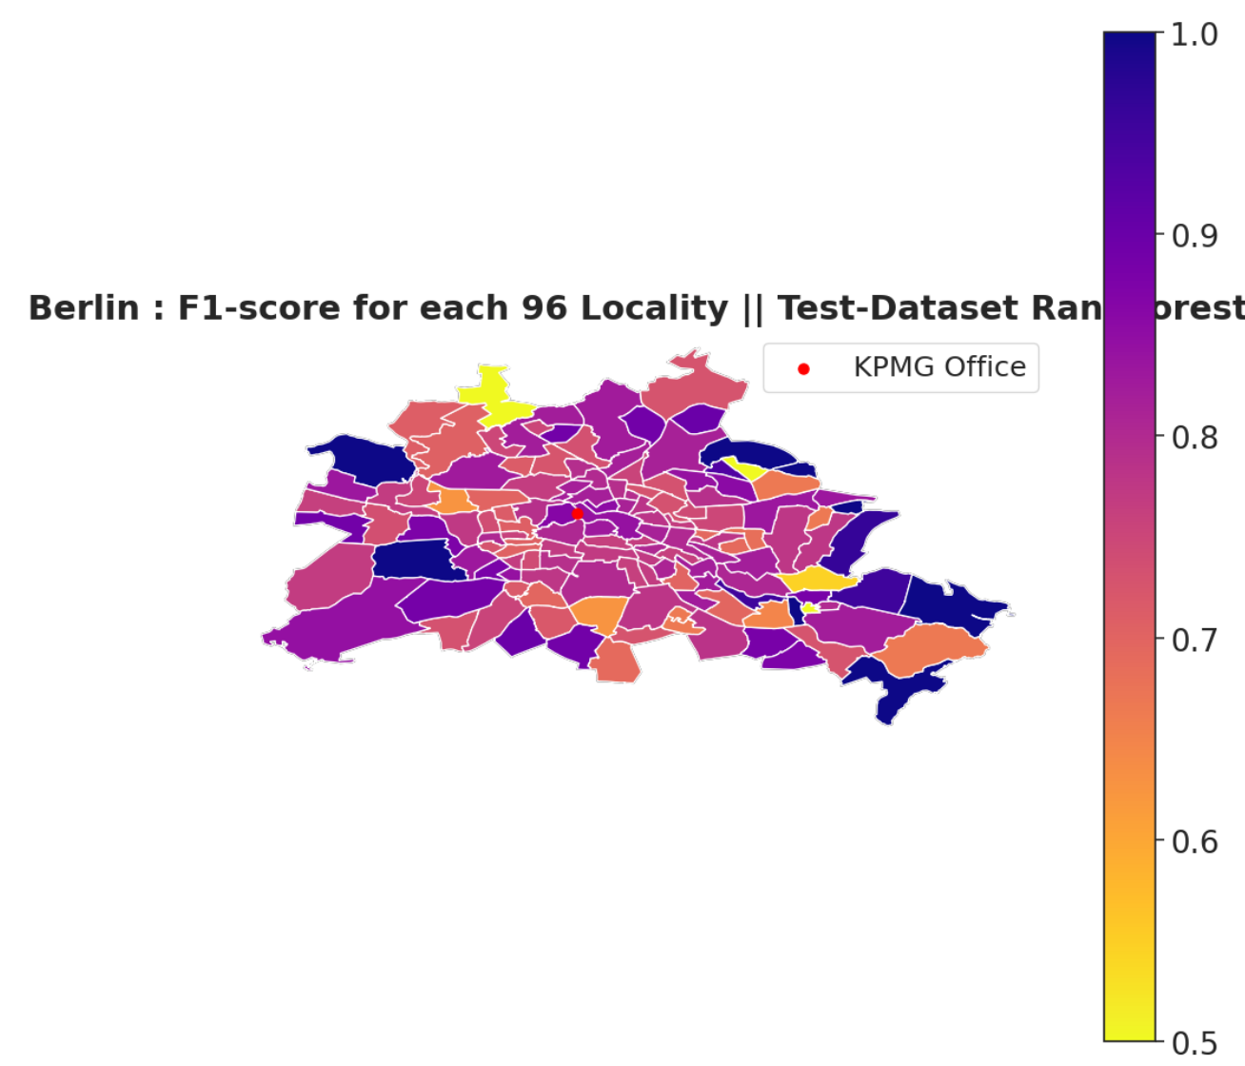
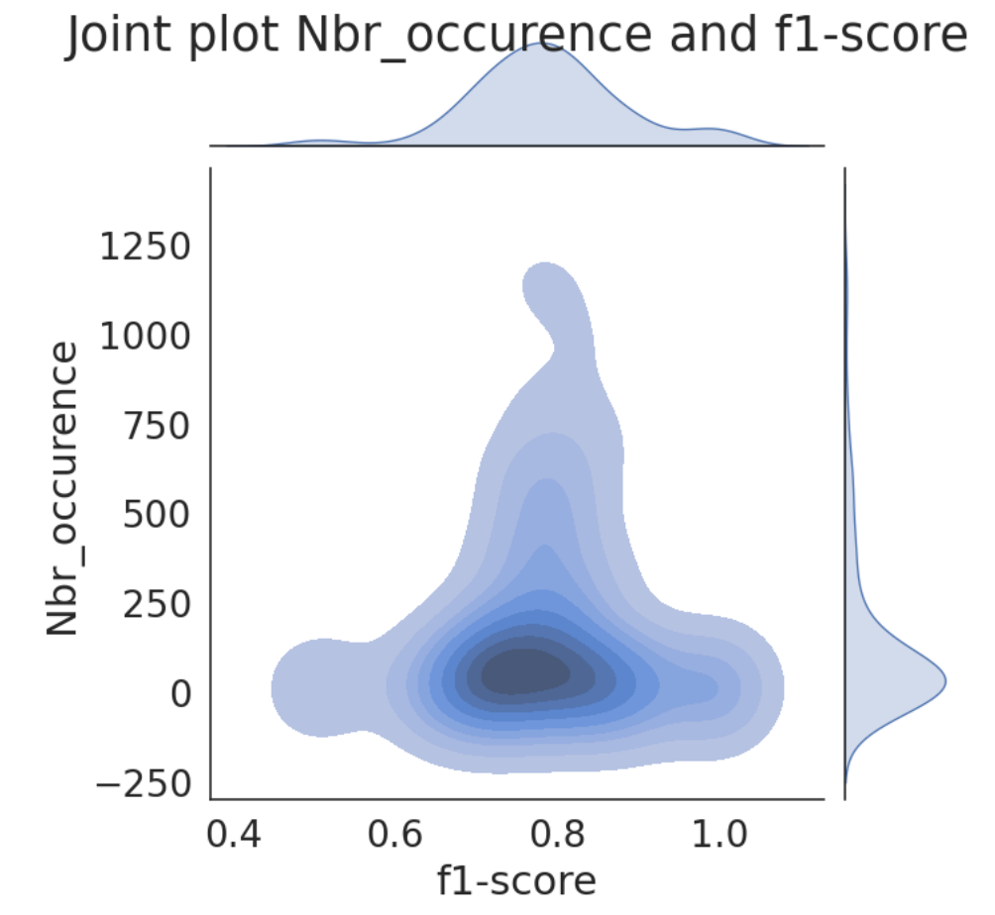
Prescriptive Analytics Finetuning the Approach
The F1 score in the Boroughs
Observation1. The F1-Score variance increase farther to KPMG
Notes:
We will now contuct the predictive analysis. We want to understand the output and linked them to our descriptive analytics.
We compute the f1score of our model per area
On the joint plot between the number of Airbnb accommodation and the f1 score we observe that the variance is higher when the number of accommodation is lower.
When we look at the right bottom graph we observe that this correspond to most of the locality not in the center

Slide 13
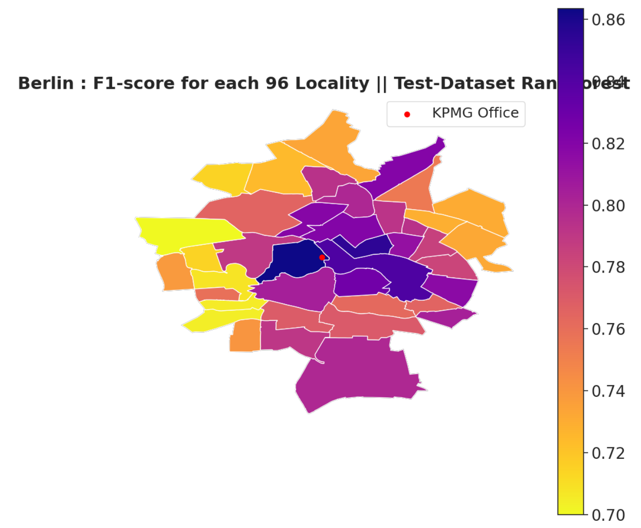
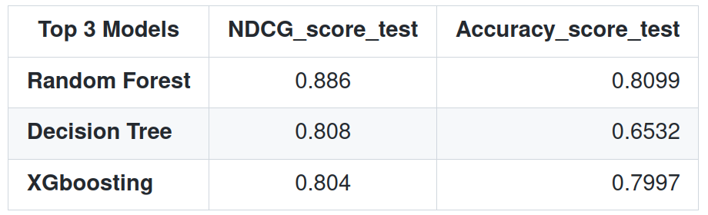
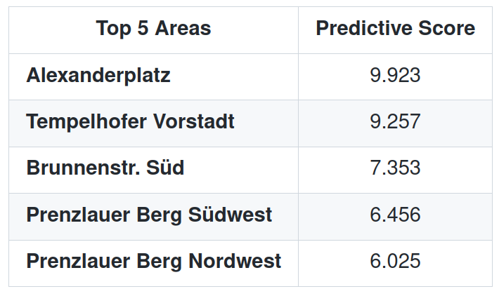
Prescriptive Analytics Finetuning the Approach
The F1 score in the Boroughs
Assumption. Rob want to live at most 5 km far from KPMG
Notes:
Now we will assume rob want to live at most 5km far from KPMG. Indeed he prefer to go by feet or by bike than speading hours in the traffic. This assumption has also the advantage to match the center of berlin. We expect therefore to have less variance in our results.
We obtain better results

Slide 14
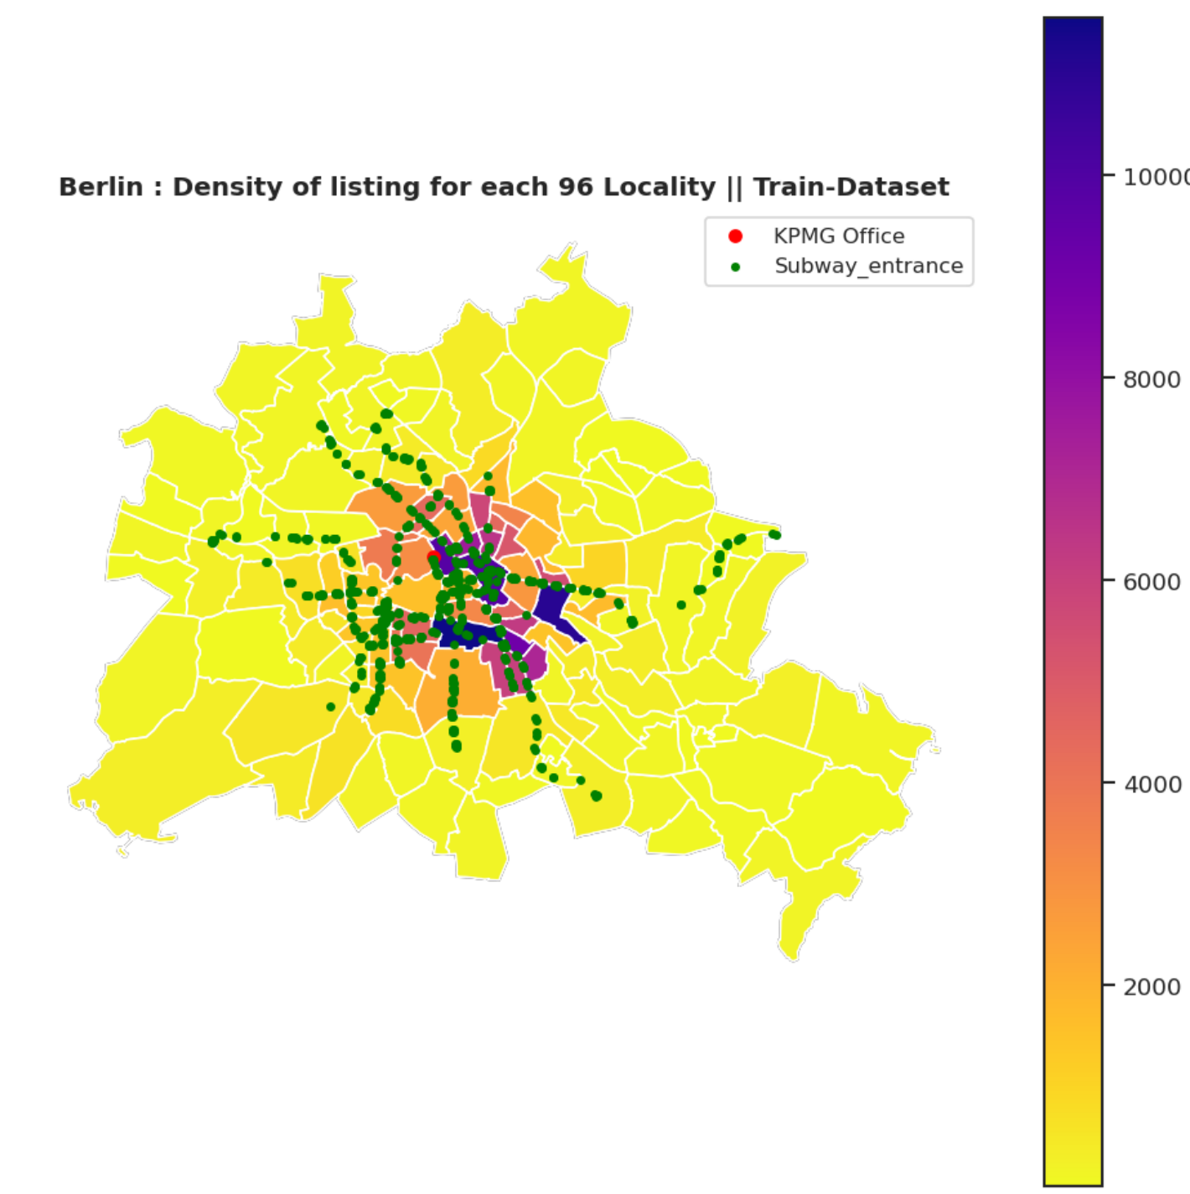

Conclusion Improvements
The Improvements
Data Centric
Add the distance to railway Station as Features
Add information about proximity with shops, cafes, bars and pubs
Add Host information
Add the review text information and compute sentimental Score
Add analysis on the pictures of the announce
Model Centric
Compute tree pruning and features selection to reduce Overfitting.
Compute Grid Search on the top models.
Try Deep Neural Networks. Less interpretability but potentially more accuracy
Notes:
During this project I try to prioritize the explanability of my result and the presentation over hunting the best model performances.
Anyway, I would like to propose some improvement of the tasks.

Slide 15
thank you.
Notes:
Thank you all for your attention

